Slide 1




NEXT GEN EMPLOYABILITY PROGRAM
Voting Application Using Django Framework
Team Members
College Name
Student Name :V. Uma Bhagavathy
Student ID :au951221104055
JP College of Engineering

Slide 2

CAPSTONE PROJECT SHOWCASE
Project Title
Notes Sharing Web Application using Django Framework
Abstract | Problem Statement | Project Overview | Proposed Solution | Technology Used | Modelling & Results | Conclusion

Slide 3
Abstract: This project aims to develop a secure and scalable voting application using the Django framework. The application will allow users to participate in various types of elections, such as governmental, organizational, or public polls, ensuring the integrity and confidentiality of the voting process. Key features include user authentication, candidate nomination, real-time result tracking, and secure data storage. The application will leverage Django's built-in security features, such as user authentication, CSRF protection, and SQL injection prevention, to ensure the integrity of the voting process. Additionally, the application will be designed to scale horizontally to handle a large number of users and votes. Overall, this project aims to provide a reliable and user-friendly platform for conducting online voting.
Source :

Slide 4
Problem Statement
Online voting systems face significant challenges related to security and scalability. Existing systems often struggle to prevent unauthorized access, ensure the integrity of the voting process, and handle a large number of users and votes efficiently. The objective of this project is to develop a secure and scalable online voting application using the Django framework. The application will address key security challenges by implementing robust authentication mechanisms, ensuring data encryption, and preventing common vulnerabilities such as SQL injection and cross-site scripting (XSS). Furthermore, the application will be designed to scale horizontally to accommodate a growing number of users and votes. This will involve optimizing database queries, using caching mechanisms, and employing load balancing techniques to distribute traffic evenly across servers. By addressing these challenges, this project aims to provide a reliable and secure platform for conducting online voting, thereby increasing voter participation and trust in the electoral process.
Source :

Slide 5
Project Overview 1. User Authentication 2. Voting process 3. Candidate Nomination 4. Real time Result Tracking 5. Security features 6. Scalability 7. Accessibility 8. Data storage
Source :

Slide 6
Proposed Solution
1. Using Django’s Authentication System
2. Develop functionalities to manage voting process
3.Allow administrator to create and manage the ballot for each voting
4. Use https for encrypt data transmission between the client and the server
5. Implement the real time result tracking for users to view updated result
Source :

Slide 7
Advantages:
Rapid Development: Django's "batteries-included" approach provides a set of tools and libraries for common web development tasks, allowing developers to build applications quickly and efficiently.
2. Scalability: Django is designed to scale horizontally, making it well-suited for applications that need to handle a large number of users and votes. It supports efficient database queries, caching, and load balancing, which are essential for scalability.
3. Authentication and Authorization: Django's authentication and authorization system makes it easy to implement user authentication and manage user roles and permissions.
4. Admin Interface: Django's admin interface allows administrators to manage the application's data, including creating and managing elections, candidates, and votes, without writing any code
Source :

Slide 8
Features:
1.User Authentication
2.Election Management
3.Candidate Management
4.Voting process
5.Real time result tracking
Source :

Slide 9


Technology Used
Front-end
Back-end
Source :

Slide 10
Modelling & Results
User Model:Represents a user of the application.Fields: username, email, password (hashed), date_joined, is_staff, is_active, is_superuser, etc.
Election Model:Represents an election.Fields: title, description, start_date, end_date, is_active, etc.
Candidate Model:Represents a candidate in an election.Fields: election (ForeignKey to Election), name, description, etc.
Vote Model:Represents a vote cast by a user in an election.Fields: election (ForeignKey to Election), candidate (ForeignKey to Candidate), voter (ForeignKey to User), timestamp, etc.
Source :

Slide 11
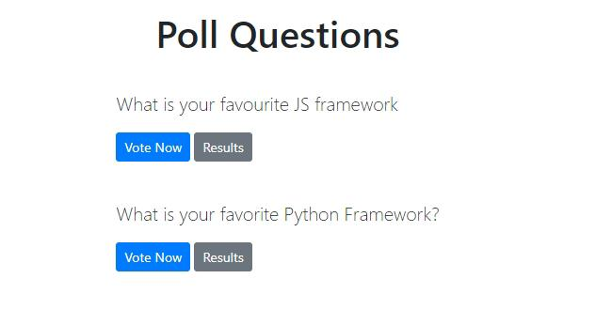
Homepage

Slide 12
About-Us-Page
1.Credibility:
The "About Us" page establishes credibility by providing information about the organization's history, mission, and team members
2.Mission and Values:
It communicates the organization's mission, values, and objectives in promoting democratic participation and decision-making.
3. Community Engagement:
The page showcases the organization's commitment to community engagement and empowerment through the voting process, inspiring active participation.
4. Contact Information:
Users can easily reach out with questions, feedback, or inquiries about the voting application through the contact information provided on the page.

Slide 13
Service-Page
1.Header Section
2.Introduction section
3.User Services
4.Administrator Services
5.Organizational Services
6.Technical Services
7.Consulting Services
8.Call to Action Services

Slide 14
Departments-Page
Header Section
Introduction Section
Department Listings
Department Details
Key Personnel
Collaboration Opportunities
Footer Section

Slide 15
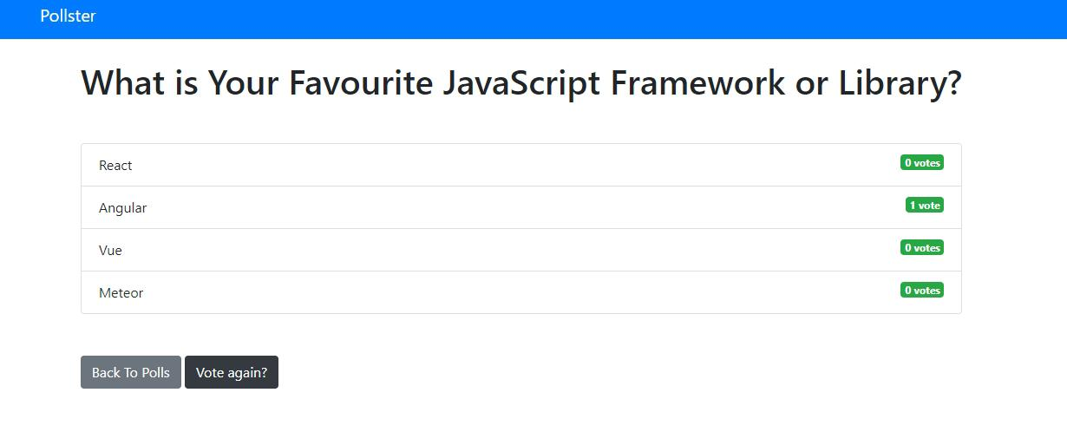
Blog-Page

Slide 16
Future Enhancements:
In the pursuit of advancing the voting application, several avenues for enhancement present themselves to enrich its functionality and user engagement.
One promising direction is the integration of advanced analytics tools, enabling administrators to glean deeper insights into voting behaviors, demographic trends, and predictive modeling for future electoral outcomes.
Furthermore, the incorporation of social media integration could amplify user engagement by allowing participants to share their voting activities and poll results seamlessly across popular platforms, fostering a wider reach and encouraging community involvement.
Real-time collaboration features offer another avenue for enhancement, empowering teams or committees to collaboratively create and refine polls, enhancing decision-making processes.

Slide 17
Conclusion
In conclusion, the development of the voting application using the Django framework has provided a solid foundation for facilitating democratic participation and decision-making processes. Through meticulous modeling of the data structure and thoughtful presentation of voting results, the application delivers a seamless and transparent user experience. However, the journey does not end here. By embracing future enhancements such as advanced analytics, social media integration, real-time collaboration, and mobile accessibility, the application can evolve to meet the evolving needs of its users and administrators. Ultimately, the voting application stands as a testament to the power of technology in fostering civic engagement, empowering individuals, and upholding the principles of democracy.
Source :

Slide 18
Thank You!
Notes:
Thank You !!

